Slide 1

Project Presentation
Name : Pilli Venkata Praneeth
University : Central University of Karnataka

Slide 2
Project Title :Stock Market Value Prediction
Purpose
With the advent of the digital computer, stock market prediction has since moved into the technological realm. The most prominent technique involves the use of artificial neural networks (ANNs) . ANNs can be thought of as mathematical function approximators. NNs require training and can have a large parameter space; it is useful to optimize the network for optimal predictive ability

Slide 3
About the project
In this project I will show you how to write a python program that predicts the price of stocks using a machine learning technique called Long Short-Term Memory (LSTM). This program is really simple and I doubt any major profit will be made from this program, but it’s slightly better than guessing! Remember the stock price can be affected by many different things.
Long short-term memory (LSTM) is an artificial recurrent neural network (RNN) architecture used in the field of deep learning. Unlike standard feed forward neural networks, LSTM has feedback connections. It can not only process single data points (such as images), but also entire sequences of data (such as speech or video). — Wikipedia
LSTMs are widely used for sequence prediction problems and have proven to be extremely effective.The reason they work so well is because LSTM is able to store past information that is important, and forget the information that is not. -Stackabuse.com

Slide 4
Start Programming:
I will start by stating what I want this program to do. I want this program to predict the prices of Apple Inc. stock 60 days in the future based off of the current Close price.
First I will write a description about the program.
# Description: This program uses an artificial recurrent neural network called Long Short Term Memory (LSTM) to predict the closing stock price of a corporation (Apple Inc.) using the past 60 day stock price.Next I will load / import the libraries that will be used throughout this program.
#Import the libraries import math import pandas_datareader as web import numpy as np import pandas as pd from sklearn.preprocessing import MinMaxScaler from keras.models import Sequential from keras.layers import Dense, LSTM import matplotlib.pyplot as plt plt.style.use('fivethirtyeight')I will get the stock quote for the company ‘Apple Inc.’ using the companies stock ticker (AAPL) from January 1st, 2012 to December 17th, 2019.

Slide 5
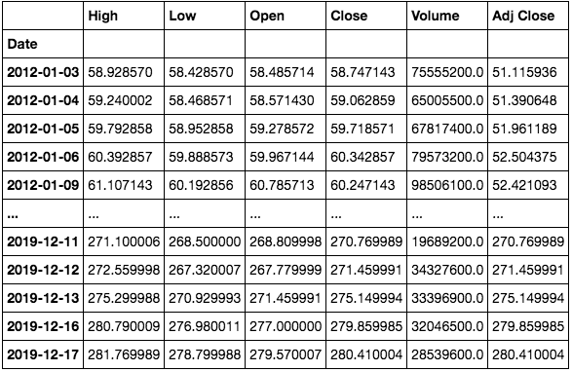
#Get the stock quote df = web.DataReader('AAPL', data_source='yahoo', start='2012-01-01', end='2019-12-17') #Show the data df

Slide 6
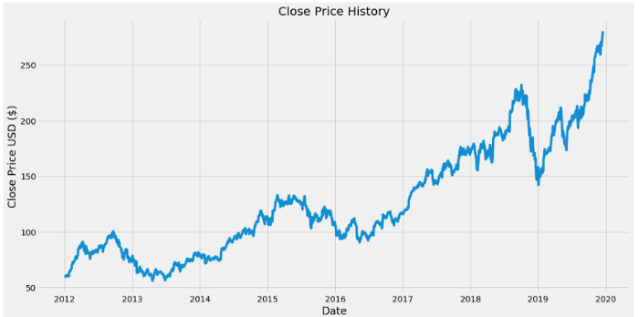
Create a graph to visualize the data.
#Visualize the closing price history plt.figure(figsize=(16,8)) plt.title('Close Price History') plt.plot(df['Close']) plt.xlabel('Date',fontsize=18) plt.ylabel('Close Price USD ($)',fontsize=18) plt.show()

Slide 7
Create a new data frame with only the closing price and convert it to an array. Then create a variable to store the length of the training data set. I want the training data set to contain about 80% of the data.
#Create a new dataframe with only the 'Close' column data = df.filter(['Close'])#Converting the dataframe to a numpy array dataset = data.values#Get /Compute the number of rows to train the model on training_data_len = math.ceil( len(dataset) *.8)
Now scale the data set to be values between 0 and 1 inclusive, I do this because it is generally good practice to scale your data before giving it to the neural network.
#Scale the all of the data to be values between 0 and 1 scaler = MinMaxScaler(feature_range=(0, 1)) scaled_data = scaler.fit_transform(dataset)

Slide 8
Create a training data set that contains the past 60 day closing price values that we want to use to predict the 61st closing price value.
So the first column in the ‘x_train’ data set will contain values from the data set from index 0 to index 59 (60 values total) and the second column will contain values from the data set from index 1 to index 60 (60 values) and so on and so forth.
The ‘y_train’ data set will contain the 61st value located at index 60 for it’s first column and the 62nd value located at index 61 of the data set for it’s second value and so on and so forth.
#Create the scaled training data set train_data = scaled_data[0:training_data_len , : ]#Split the data into x_train and y_train data sets x_train=[] y_train = [] for i in range(60,len(train_data)): x_train.append(train_data[i-60:i,0]) y_train.append(train_data[i,0])

Slide 9
Now convert the independent train data set ‘x_train’ and dependent train data set ‘y_train’ to numpy arrays so they can be used for training the LSTM model.
#Convert x_train and y_train to numpy arrays x_train, y_train = np.array(x_train), np.array(y_train)Reshape the data to be 3-dimensional in the form [number of samples, number of time steps, and number of features]. The LSTM model is expecting a 3-dimensional data set.
#Reshape the data into the shape accepted by the LSTM x_train = np.reshape(x_train, (x_train.shape[0],x_train.shape[1],1))
Build the LSTM model to have two LSTM layers with 50 neurons and two Dense layers, one with 25 neurons and the other with 1 neuron.
#Build the LSTM network model model = Sequential() model.add(LSTM(units=50, return_sequences=True,input_shape=(x_train.shape[1],1))) model.add(LSTM(units=50, return_sequences=False)) model.add(Dense(units=25)) model.add(Dense(units=1))

Slide 10
Compile the model using the mean squared error (MSE) loss function and the adam optimizer.
#Compile the model model.compile(optimizer='adam', loss='mean_squared_error')Train the model using the training data sets. Note, fit is another name for train. Batch size is the total number of training examples present in a single batch, and epoch is the number of iterations when an entire data set is passed forward and backward through the neural network.
#Train the model model.fit(x_train, y_train, batch_size=1, epochs=1)
Create a test data set.
#Test data set test_data = scaled_data[training_data_len - 60: , : ]#Create the x_test and y_test data sets x_test = [] y_test = dataset[training_data_len : , : ] #Get all of the rows from index 1603 to the rest and all of the columns (in this case it's only column 'Close'), so 2003 - 1603 = 400 rows of data for i in range(60,len(test_data)): x_test.append(test_data[i-60:i,0])

Slide 11
Then convert the independent test data set ‘x_test’ to a numpy array so it can be used for testing the LSTM model.
#Convert x_test to a numpy array x_test = np.array(x_test)Reshape the data to be 3-dimensional in the form [number of samples, number of time steps, and number of features]. This needs to be done, because the LSTM model is expecting a 3-dimensional data set.
#Reshape the data into the shape accepted by the LSTM x_test = np.reshape(x_test, (x_test.shape[0],x_test.shape[1],1))Now get the predicted values from the model using the test data.
#Getting the models predicted price values predictions = model.predict(x_test) predictions = scaler.inverse_transform(predictions)#Undo scaling

Slide 12
Get the root mean squared error (RMSE), which is a good measure of how accurate the model is. A value of 0 would indicate that the models predicted values match the actual values from the test data set perfectly.
The lower the value the better the model performed. But usually it is best to use other metrics as well to truly get an idea of how well the model performed.
#Calculate/Get the value of RMSE rmse=np.sqrt(np.mean(((predictions- y_test)**2))) rmse
The RMSE value

Slide 13
Let’s plot and visualize the data.
#Plot/Create the data for the graph train = data[:training_data_len] valid = data[training_data_len:] valid['Predictions'] = predictions#Visualize the data plt.figure(figsize=(16,8)) plt.title('Model') plt.xlabel('Date', fontsize=18) plt.ylabel('Close Price USD ($)', fontsize=18) plt.plot(train['Close']) plt.plot(valid[['Close', 'Predictions']]) plt.legend(['Train', 'Val', 'Predictions'], loc='lower right') plt.show()

Slide 14
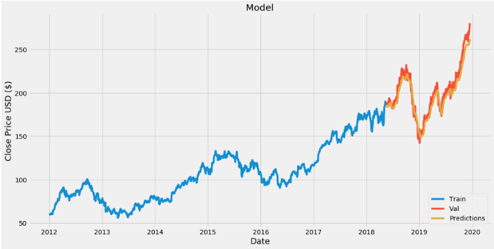
Actual Vs predicted values Comparition

Slide 15
I want to test the model some more and get the predicted closing price value of Apple Inc. for December 18, 2019 (12/18/2019).
So I will get the quote, convert the data to an array that contains only the closing price. Then I will get the last 60 day closing price and scale the data to be values between 0 and 1 inclusive.
After that I will create an empty list and append the past 60 day price to it, and then convert it to a numpy array and reshape it so that I can input the data into the model.
Last but not least, I will input the data into the model and get the predicted price.

Slide 16
#Get the quote apple_quote = web.DataReader('AAPL', data_source='yahoo', start='2012-01-01', end='2019-12-17')#Create a new dataframe new_df = apple_quote.filter(['Close'])#Get teh last 60 day closing price last_60_days = new_df[-60:].values#Scale the data to be values between 0 and 1 last_60_days_scaled = scaler.transform(last_60_days)#Create an empty list X_test = []#Append teh past 60 days X_test.append(last_60_days_scaled)#Convert the X_test data set to a numpy array X_test = np.array(X_test)#Reshape the data X_test = np.reshape(X_test, (X_test.shape[0], X_test.shape[1], 1))#Get the predicted scaled price pred_price = model.predict(X_test)#undo the scaling pred_price = scaler.inverse_transform(pred_price) print(pred_price)
The predicted price for 12/18/2019Now let’s see what the actual price for that day was.
#Get the quote apple_quote2 = web.DataReader('AAPL', data_source='yahoo', start='2019-12-18', end='2019-12-18')print(apple_quote2['Close'])
The actual price for 12/18/2019

Slide 17
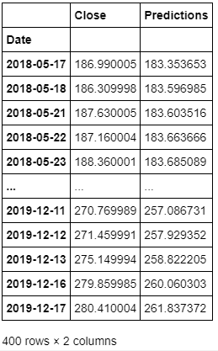
#Show the valid and predicted prices valid

Slide 18


